Slide 1
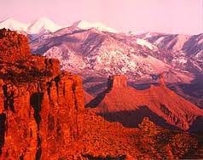
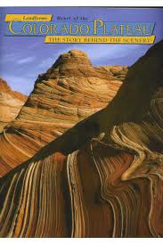

Science

Slide 2
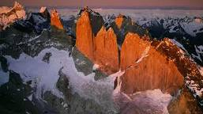

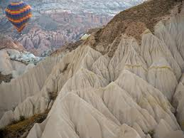
A natural structure on the surface of the earth.
These are examples, which is another example?

Slide 3

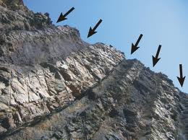
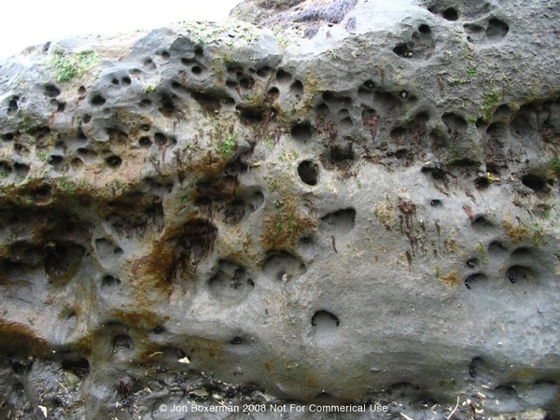
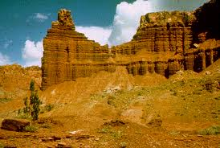
The breaking down of rock on the surface of the earth usually by the force of water, wind or ice.
The weather changes our landforms, that is why it is called weathering!!

Slide 4

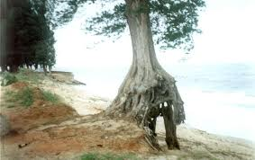
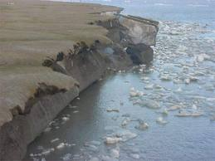
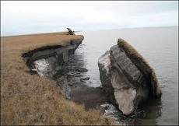
Movement of weathered particles.
Which particles are under erosion on these pictures?

Slide 5
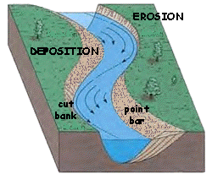

The process in which materials that have been eroded are dropped in a new place.

Slide 6

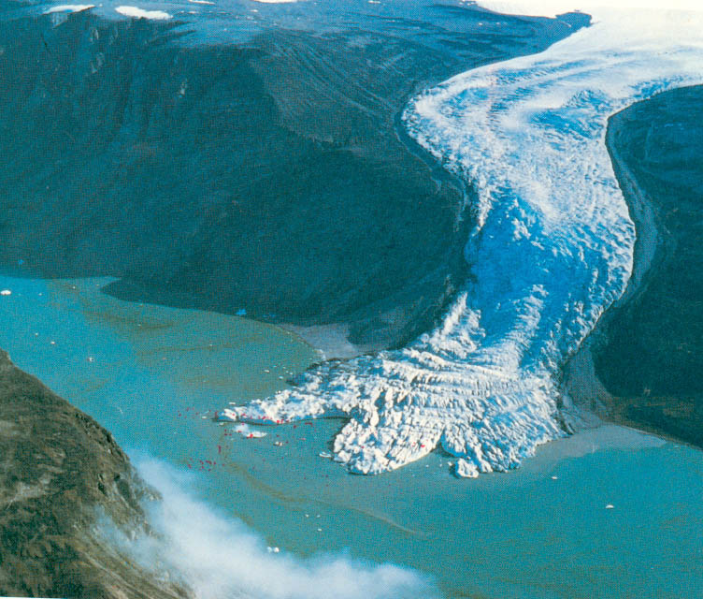
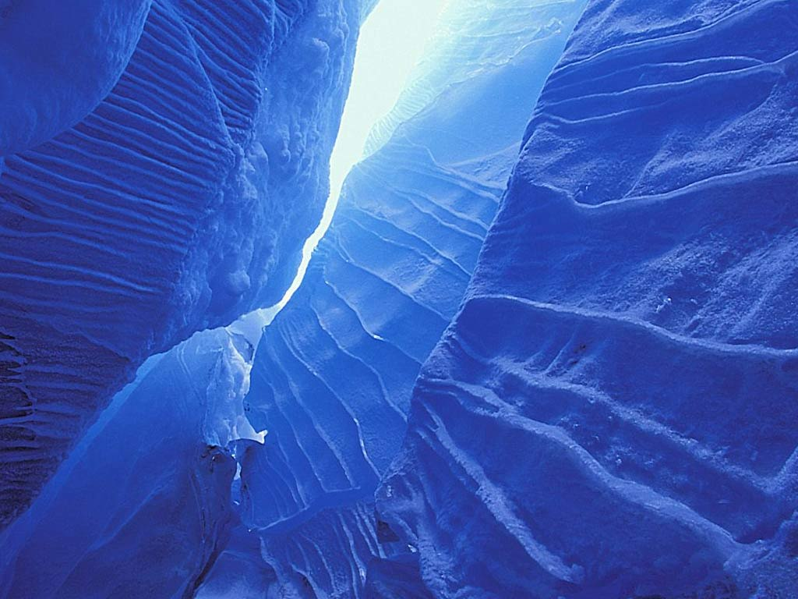
Huge piece of ice that slowly moves across the surface of the earth and remains frozen during the entire year.

Slide 7

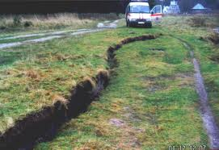
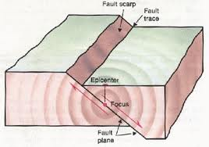
A crack in earths crust.
Think of it as a place you could FALL!

Slide 8

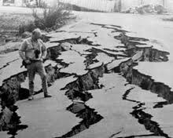
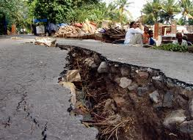
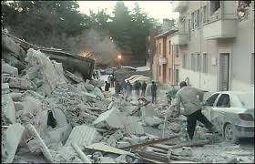
The shaking of earths crust caused by large pieces of rock underneath the earths surface moving against each other.

Slide 9

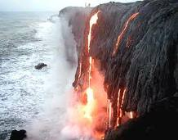
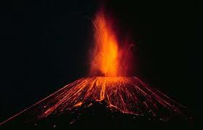
A mountain made from harden lava, rocks and ash that erupted out from underneath earths surface.

Slide 10

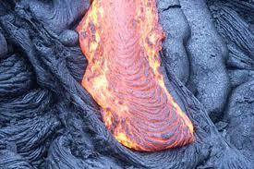
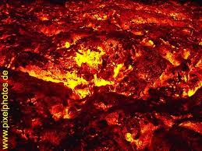
Melted rock below the earths surface.
When it is still inside of the volcano.

Slide 11

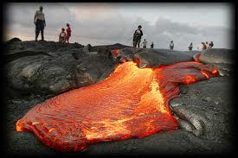
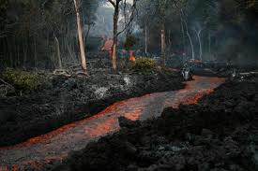
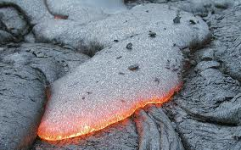
Magma that has flowed out onto the surface of the earth.
When its outside of the volcano.

Slide 12

Weathering
Erosion
Deposition
Landform
Glacier
Fault
Earthquake
Volcano
Magma
Lava

Slide 13

http://www.guardian.co.uk/world/video/2010/mar/25/iceland-volcano-eruption
Video of a volcano erupting lava.
If you could see it is lava,
If you can’t see magma. ☺

Slide 14

…………………………………………………………………………………………………………………..

